Slide 1
Roadmap for the Next Two Weeks
15. T Mar 17: 4.4. Convergence and Its Absence
Read Before: J. Bradford DeLong (1986): Productivity Growth, Convergence, and Welfare: Comment <https://github.com/braddelong/public-files/blob/master/delong-baumol.pdf>
Read Before: Dev Patel, Justin Sandefur, and Arvind Subramanian (2019): Everything You Know about Cross-Country Convergence Is (Now) Wrong <https://www.piie.com/blogs/realtime-economic-issues-watch/everything-you-know-about-cross-country-convergence-now-wrong>
Slides: <https://github.com/braddelong/public-files/blob/master/econ-135-lecture-15.pptx>
Start: Assignment 7 (6 pts): <https://bcourses.berkeley.edu/courses/1487685/assignments/8082488> Tell Us What Is Happening to You, and What You Wish For; due Mar 20
16. Th Mar 19: 4.5. Inequality and Plutocracy
Slides: <https://github.com/braddelong/public-files/blob/master/econ-135-lecture-16.pptx>
Finish: Assignment 7 (6 pts): <https://bcourses.berkeley.edu/courses/1487685/assignments/8082488> Tell Us What Is Happening to You, and What You Wish For; due Mar 20
Start: Assignment 8: character of modern economic growth paper; due Mar 25
17. Tu Mar 31: 4.6. The Development of Underdevelopment
Read After: W. Arthur Lewis (1978): Evolution of the International Economic Order <https://delong.typepad.com/sdj/2008/04/w-arthur-lewis.html>
Slides: <https://github.com/braddelong/public-files/blob/master/econ-135-lecture-17.pptx>
Finish: Assignment 8: post-1500 growth accelerations paper; due Apr 1
Start: Assignment 9: character of modern economic growth paper; due Apr 8
18. Th Apr 2: Touring the Continents: 5.1. Western Europe, North America, and South America
Read Before: Joel Mokyr (1990): Lever of Riches, chapter 10 Britain and Europe <https://delong.typepad.com/files/mokyr-lever-europe.pdf>
Read Before: John Coatsworth (2008).: Inequality, Institutions and Economic Growth in Latin America <https://delong.typepad.com/files/coatsworth-institutions.pdf>
Slides: <https://github.com/braddelong/public-files/blob/master/econ-135-lecture-18.pptx>

Slide 2
Coronavirus!
With 31 deaths in the U.S. as of March 11, a 1% death rate, and up to 4 weeks between infection and death, that means that as of Feb 12 there were 3100 coronavirus cases in the United States.
With 73 deaths in the U.S. as of Mar 16, a 1% death rate, and up to 4 weeks between infection and death, that means that as of Feb 17 there were 7300 coronavirus cases in the United States
If it is doubling every seven days, then now about 116,000 people have and in the next week about 116,000 more people in the U.S. will catch coronavirus—which means 1/2700, currently 3000 of the 7.6 million inhabitants of San Francisco Bay. Touch a hard surface that any of those 3000 has touched in the last 48 hours, and the virus has a chance to jump to you…
These numbers could be five times too big. These numbers are probably not five times too small unless the thing is a lot less deadly, and there are a lot of asymptomatic cases…
What is wrong with this analysis?

Slide 3
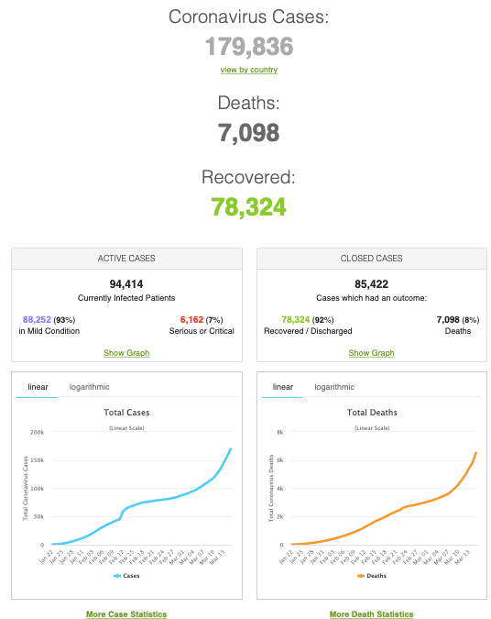
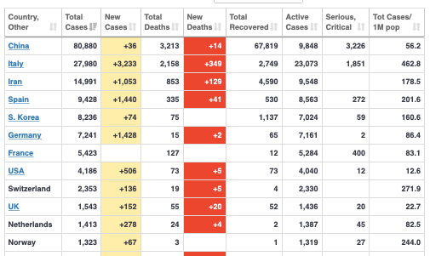
MOAR Coronavirus!
As of March 16: Things are not moving in the right direction:
What is the R0?
How can the R0 be changed?
How will the R0 change?
What is the asymptote share of the population?
What is the mortality rate?

Slide 4
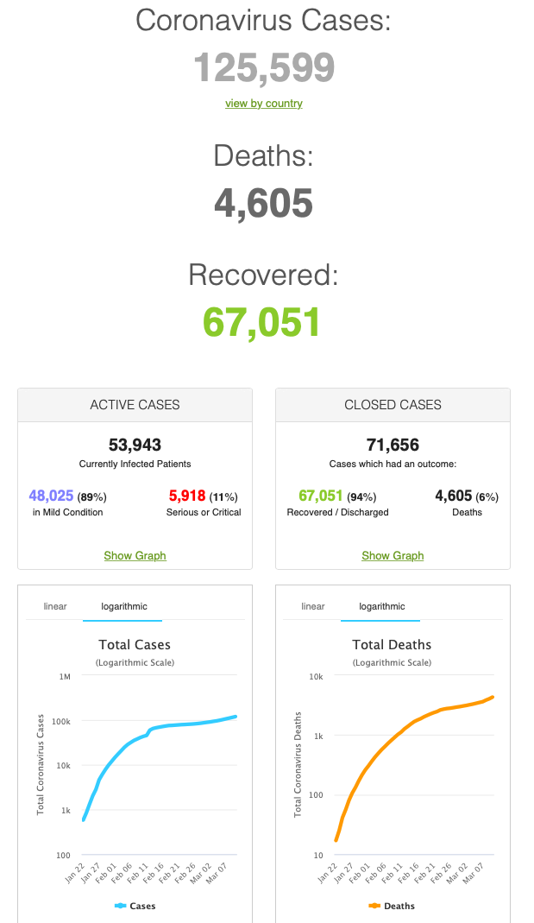
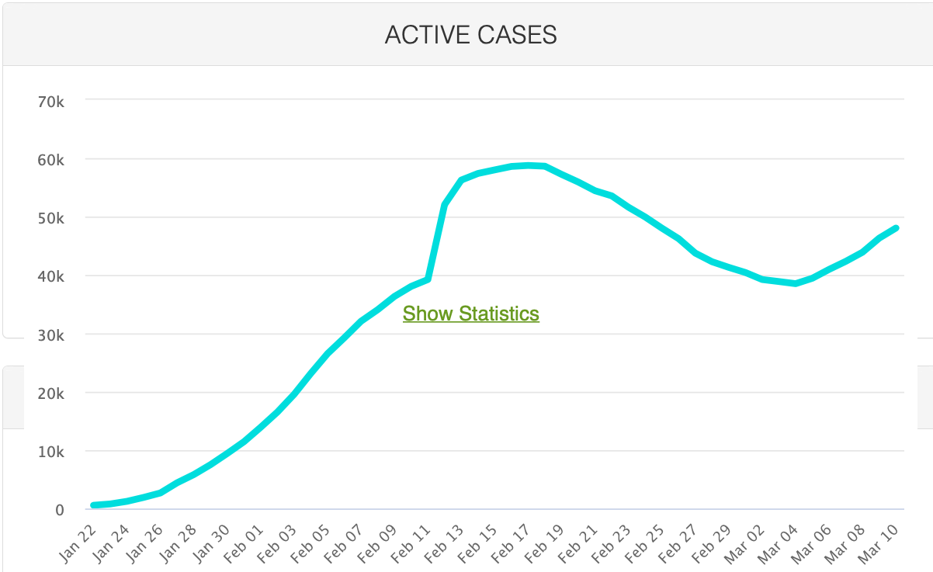
MOAR Coronavirus!
As of March 10: Things are not moving in the right direction:
What is the R0?
How can the R0 be changed?
How will the R0 change?
What is the asymptote share of the population?
What is the mortality rate?

Slide 5
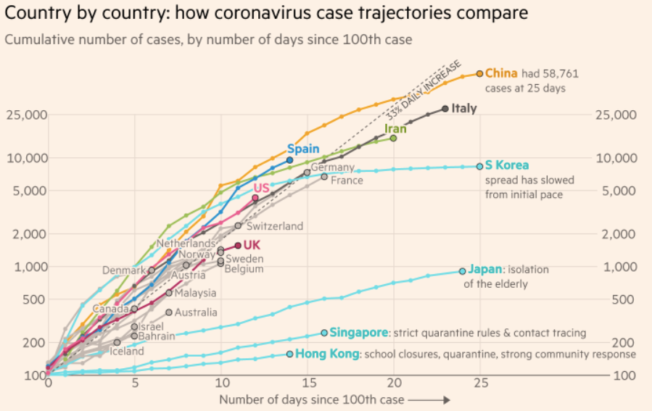
MOAR Coronavirus!
What I am watching:
Max Roser & Hannah Ritchie: Coronavirus Disease (COVID-19)_ <https://ourworldindata.org/coronavirus>…
Worldometer: Coronavirus Update (Live) <https://www.worldometers.info/coronavirus/>: ‘125,599 Cases and 4,605 Deaths from COVID-19 Virus Outbreak…
FT Coronavirus Tracker <https://www.ft.com/content/a26fbf7e-48f8-11ea-aeb3-955839e06441>
<https://www.nytimes.com/interactive/2020/us/coronavirus-us-cases.html>

Slide 6
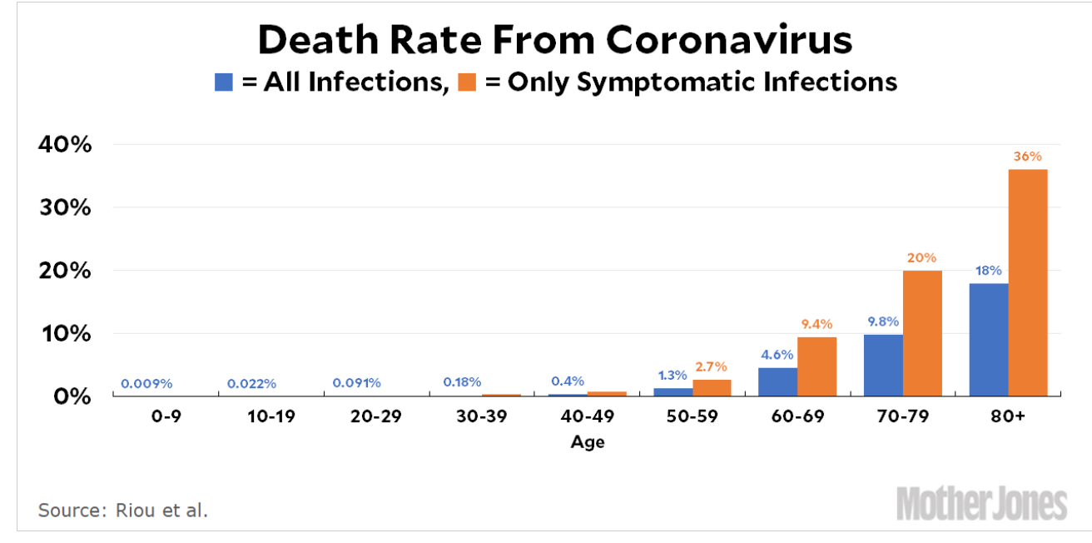
MOAR Coronavirus!
It’s a Thing for Geezers!
Mortality for the Youngs very low…
It’s the flu for them…

Slide 7
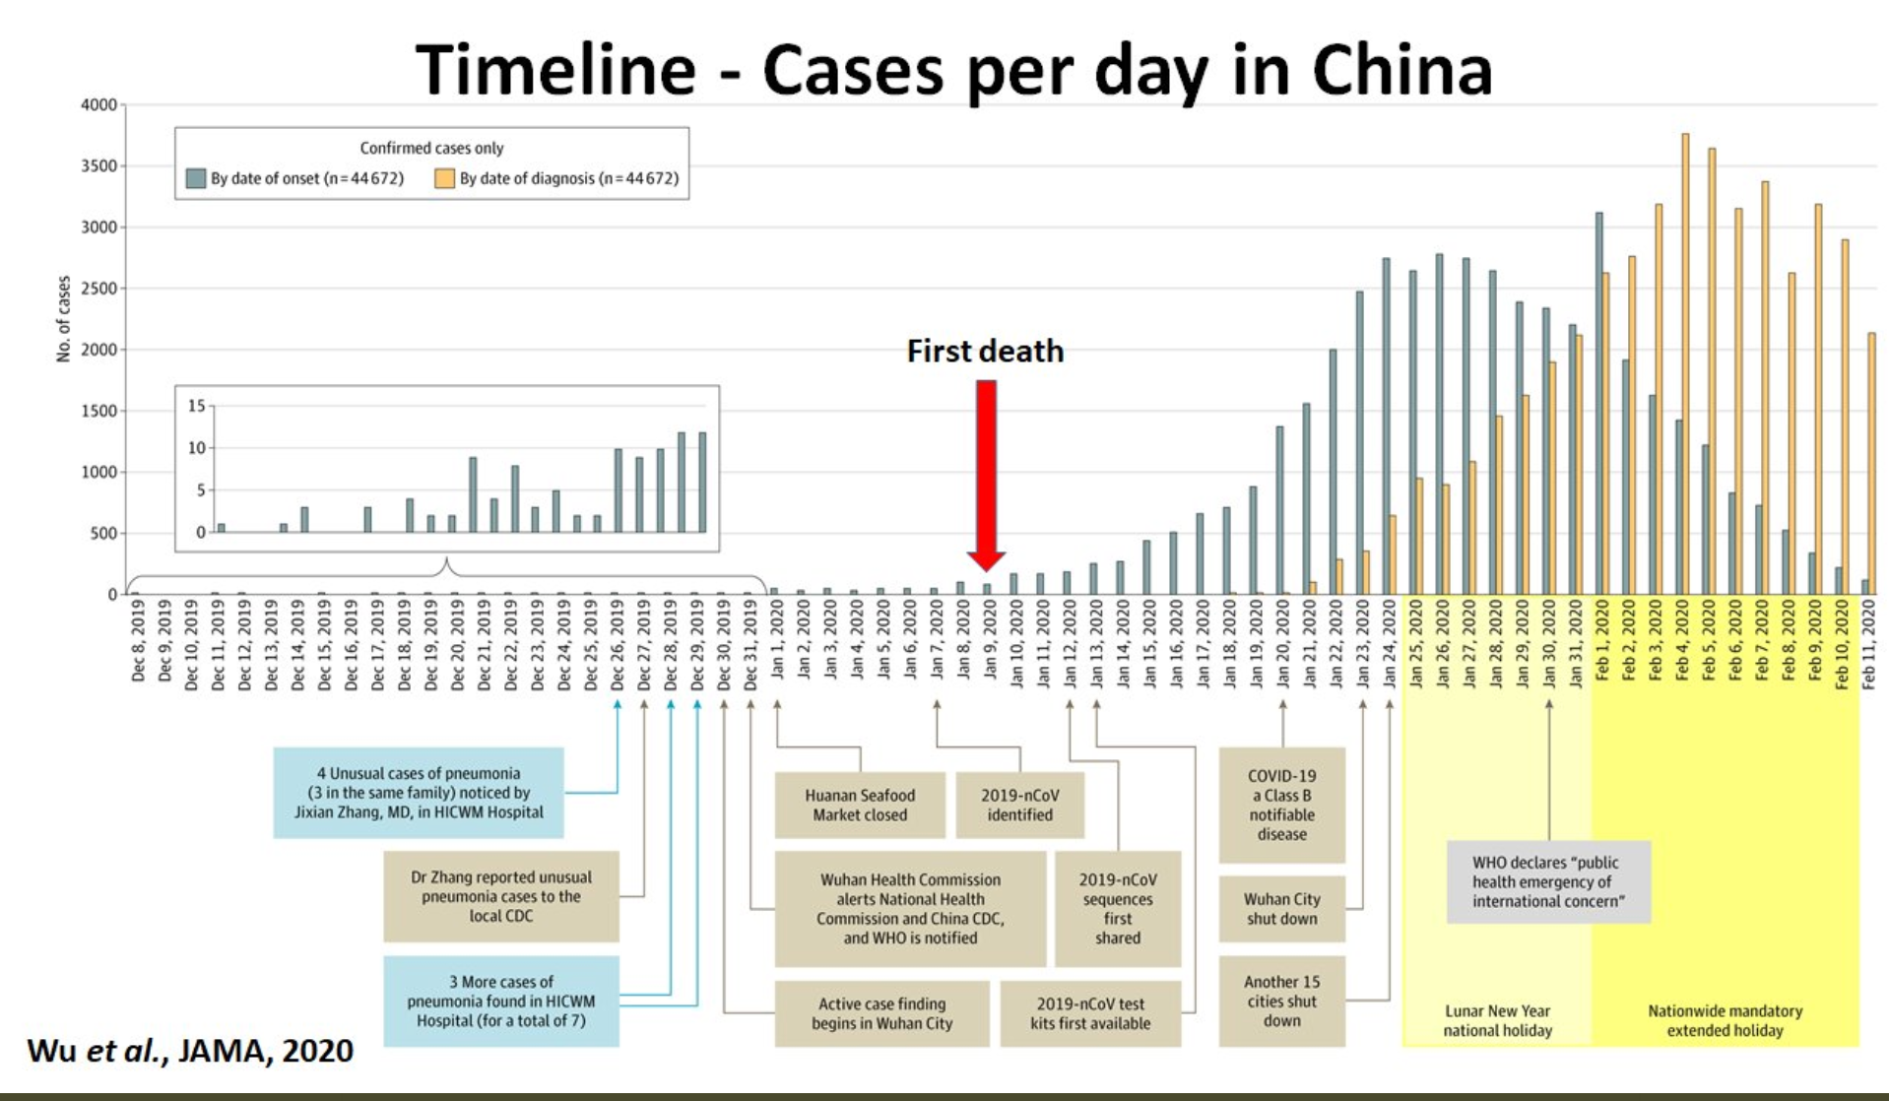
MOAR Coronavirus! II
China Beat It!
Shut down Wuhan when 200 cases per day
That seems to have been a good decision

Slide 8
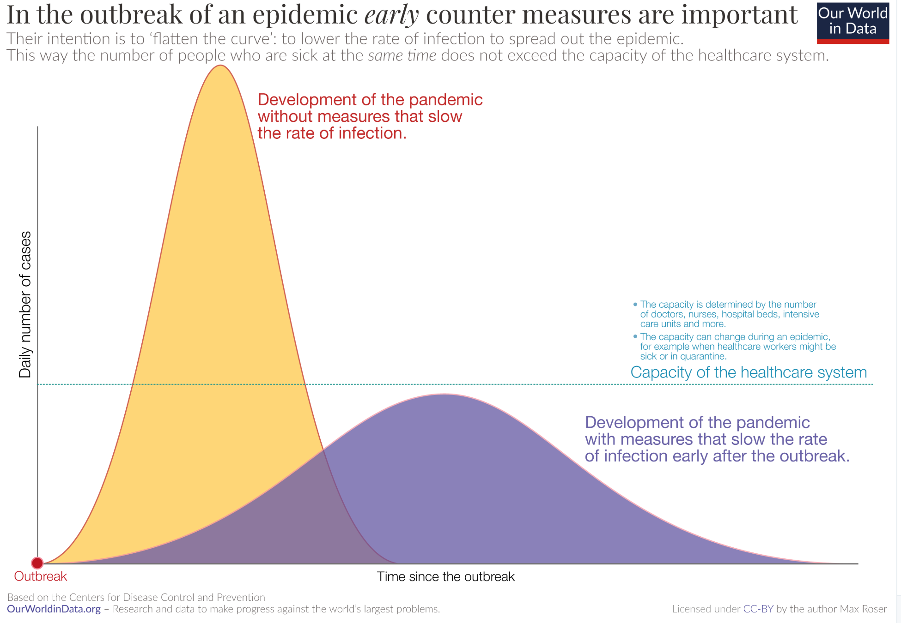
MOAR Coronavirus! III
When Is It Appropriate to Move on This?
Immediate social distancing…
Self-isolate if you have a cough and a fever…
Hope that warmer temperatures will do to this what they did to SARS…
Otherwise, when do you want to start spreading out transmission. It seems that early is as good as later…

Slide 9
Catch Our Breath…
Ask a couple of questions?
Make a couple of comments?
Any more readings to recommend?

Slide 10
Notes

Slide 11
Lecture 15:
4.4. Convergence and Its Absence
Brad DeLong
Department of Economics & Blum Center, U.C. Berkeley; & WCEG
last revised: Mo 2020-03-16
for presentation: Tu 2020-03-17
Original course by Melissa Dell (Harvard Econ 1342), revised by Brad DeLong
<https://github.com/braddelong/public-files/blob/master/econ-135-lecture-15.pptx>

Slide 12
Big Ideas: Lecture 14: Globalization Advances and Retreats
Takeaways from last lecture:
Give me five…

Slide 13
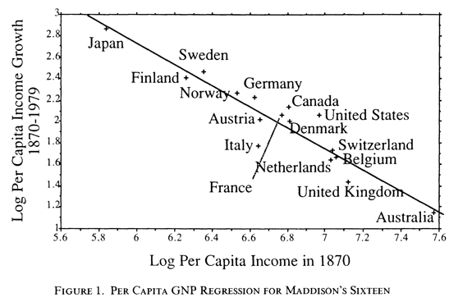
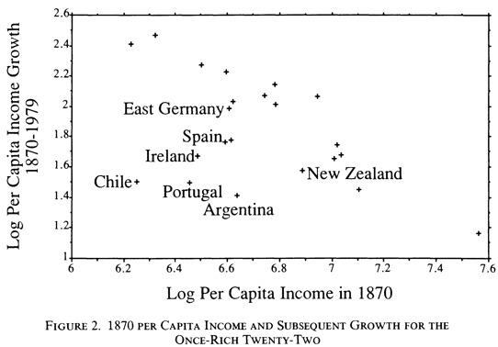

Convergence’s Absence
Expected convergence:
Economists have always expected the "convergence"of national productivity levels
The theoretical logic behind this belief is powerful.
Will Baumol expressing conventional wisdom
Personal biography
2:00

Slide 14
Convergence’s Theoretical Logic
Expected by everyone—even Marx—back to before 1850:
The theoretical logic behind this belief is powerful.
The per capita income edge of the West is based on its application of the storehouse of industrial and administrative technology of the Industrial Revolution.
This storehouse is open: modern technology is a public good.
* The benefits of tapping this storehouse are great
So nations will strain every nerve to assimilate modern technology and their incomes will converge to those of industrial nations.
2:15

Slide 15
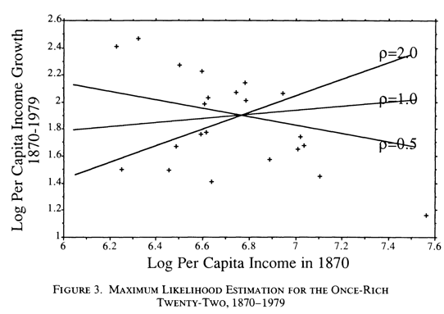
But the Now-Rich Sixteen Is the Wrong Group to Look at
Looking at today’s rich countries traps you into looking at a very selected sample:
Suppose you look at all countries that had achieved substantial economic progress by 1870?
Then you add Argentina, Chile, East Germany, Ireland, Portugal, New Zealand, and Spain
And suppose you add some awareness that our data in 1870 is measured with substantial error
Error uncorrelated with our estimates of prosperity today
2:30

Slide 16
There Is No Convergence Tendency
Do these two things:
Then any convergence tendency in the data disappears
This is much stronger than “there is divergence because some countries had good institutions, and others could not learn”
This is, rather: “even if you have good institutions at one particular point in time, it can still get very messed up”
But perhaps the once-rich twenty-two contained some countries that were rich by accident, and thus should not be in a sample of countries that had successfully developed “modernizing institutions”?
2:15

Slide 17
Can You Rescue Convergence
Might the once-rich twenty-two also be the wrong group to look at?:
Perhaps the once-rich twenty-two contained some countries that were rich by accident
Consider OPEC today
Countries rich by accident thus should not be in a sample of countries that had successfully developed “modernizing institutions”
1:30

Slide 18
What Did People Think at the Time
Let’s look at investors’ judgments as of 1913:
The volume of overseas investment poured into the additional nations by investors from London and Paris between 1870 and 1913 tells us that investors thought these nation's development prospects good
The six non-European nations among the top ten recipients of investment per capita from France and Britain, and four of the five top recipients of investment belong to the once- rich twenty-two
Every pound or franc invested is an explicit bet that the recipient country's rate of profit will remain high and an implicit bet that its rate of economic growth would be rapid
The coincidence of the nations added on a per capita income basis and the nations that would have been added on a foreign investment basis is powerful evidence that these nations do belong in the potential convergence club
3:30

Slide 19
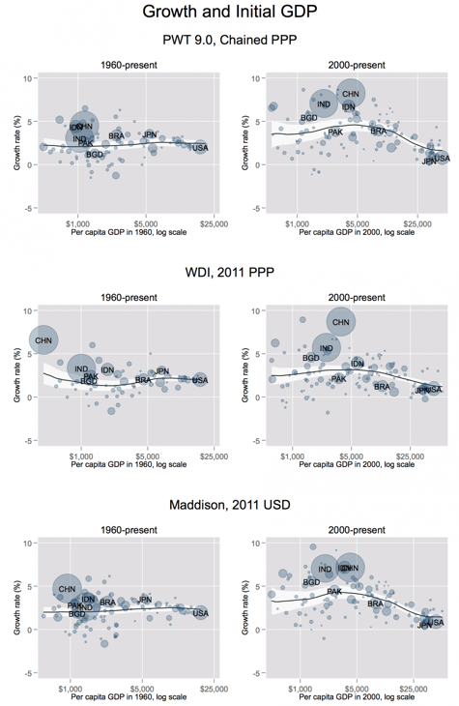
There Was No Convergence Tendency
Patel, Sandefur, and Subramanian: “Our basic point doesn’t even require regressions”
But they do them nonetheless
Their argument is that there did not use to be convergence—back before 1990 there was not: there was divergence
But something changed between 1990 and 2000
And since 2000 there has been strong “convergence”
There is every reason to think—hope—that this strong convergence will continue into the future
What is this post-2000 convergence due to? We can think about that at the end…
1:40

Slide 20
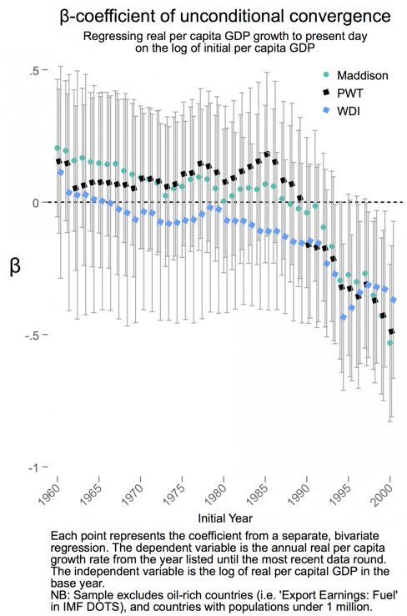
Changes since 1990
Things today are different than they were in 1990:
The world has changed from 1990-2020
Unconditional convergence was singularly absent in the past
There has been unconditional convergence:
Beginning (weakly) around 1990
Emphatically for the last two decades
3:00

Slide 21
But There Is No Convergence Tendency
Patel, Sandefur, and Subramanian: “Our basic point doesn’t require regressions”
[Of] the 43 countries the World Bank classified as “low income” in 1990, 65 percent have grown faster than the high-income average since 1990
The same is true for 82 percent of the 62 middle-income countries circa 1990
Not just that poor countries have sped up
Also that rich countries have slowed down
1:15

Slide 22
The Old Empirical Growth Literature
Patel, Sandefur, and Subramanian:
The conclusion of the empirical growth literature in the 1990s was that convergence was conditional on poor countries achieving the level of human capital and governance in rich countries
Economists’ standard “all else equal” fudge
Dowrick and Delong (2003) noted this was…absurd
Bangladesh can’t become Belgium overnight
It didn’t have to
Developing countries have managed to grow faster without such radical changes in their endowments or institutions
3:45

Slide 23
What Caused Post-2000 Convergence?
Patel, Sandefur, and Subramanian do not say:
Let’s think about this…
What are the obvious candidates?
The Great Recession and the Anemic Recovery
Institutional dysfunction in the Global North
Austerity and a failure to prioritize a return to full employment and growth
The coming of the value-chain economy
No longer having to keep your blue-collar assembly-line workers close to your engineers, your executives, and your brand creators
Modern information and communications technologies more generally
The internet
Reduced distance in general—transoceanic airplane flights at a greatly increased pace
5:30

Slide 24
Discussion
Convergence and Its Absence:
What strikes you as important here?

Slide 25
Big Ideas: Lecture 15: Convergence & Its Absence
Takeaways from this class:

Slide 26
Catch Our Breath…
Ask a couple of questions?
Make a couple of comments?
Any more readings to recommend?

Slide 27
Notes

